Slide 1
TDD
Test Driven Development
BY ALTOTECH

Slide 2
What is TDD?
TDD = TFD + Refactoring
Test-driven development is a development concept when the tests are written before the code. In practical, Developer start the development process by writing unit-test before writing actual code implementation.
By doing this, we ensure that However the code implement, It’s not affecting the final goal.
TDD was introduced by XP (Extreme Programming) is an agile software development framework

Slide 3
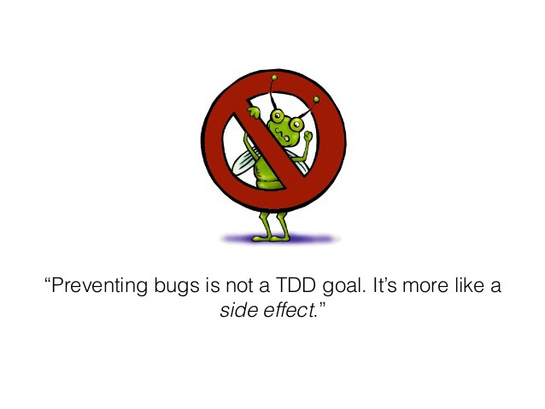
Why you should do TDD?
KILL THE BUG

Slide 4
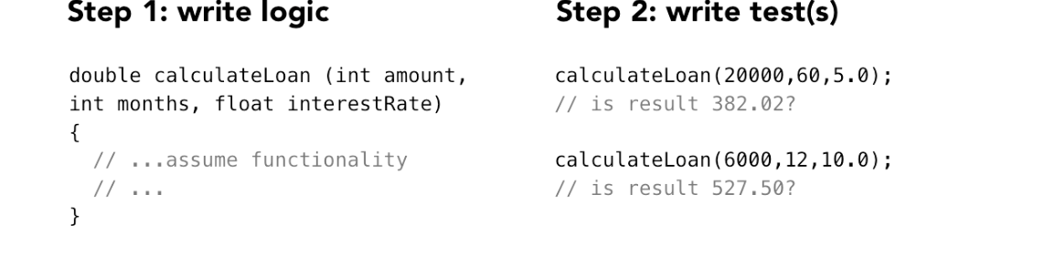
Unit testing - but not TDD

Slide 5
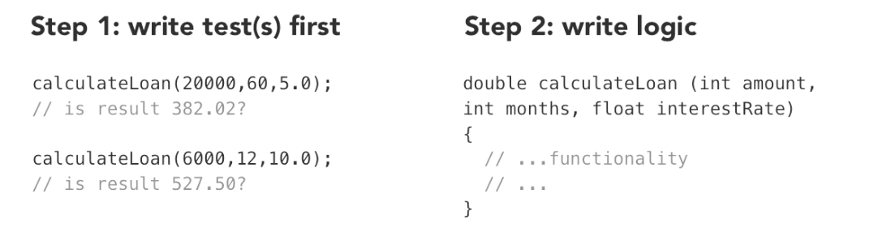
Test-Driven Development

Slide 6
TDD is not just development that uses unit tests

Slide 7
Test-Driven Development
as a process and technique
is all about the priority and the position that we give to those unit tests

Slide 8
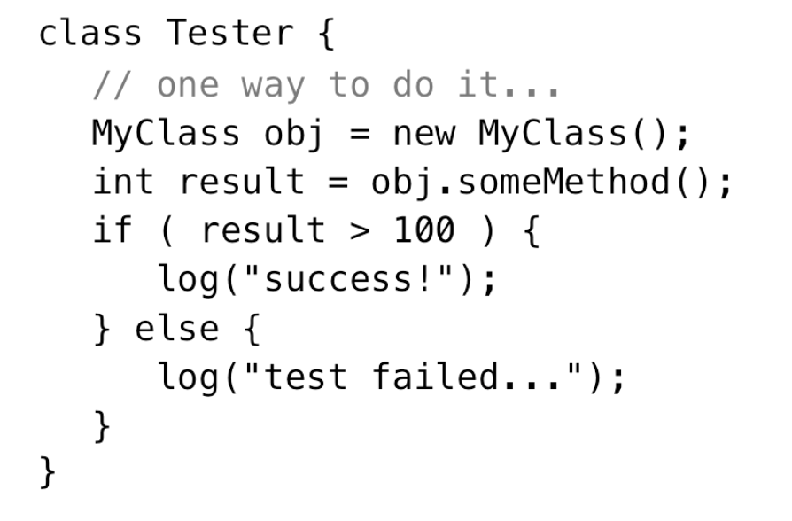
Using Unit Test Frameworks
Example
http://junit.org for Java
http://www.nunit.org for Python

Slide 9
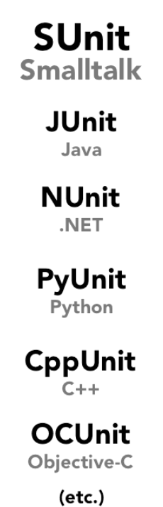

Slide 10
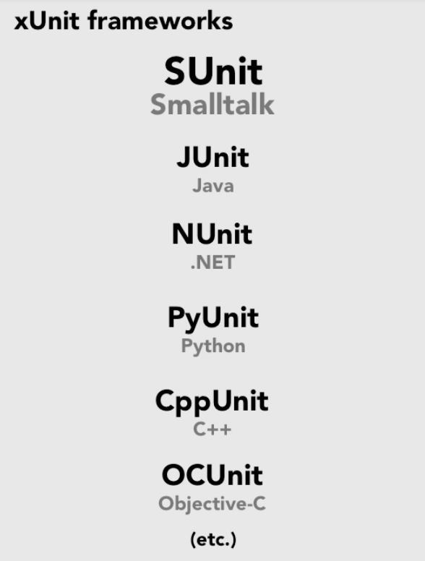

Slide 11
Assertion
Stating something to be true/false

Slide 12
Assertion
Using in Code

Slide 13
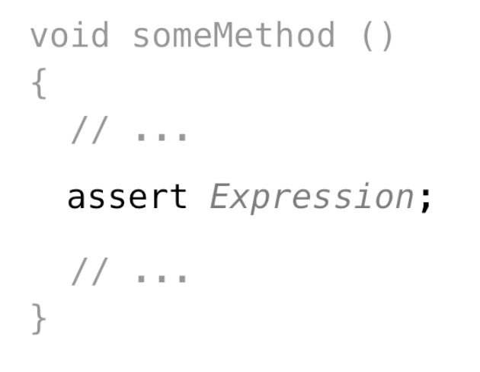
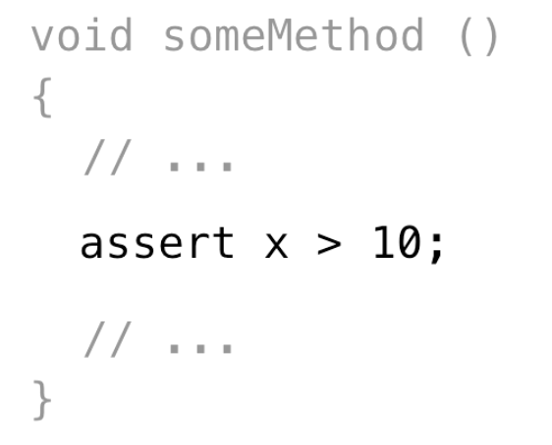
Assert in Java

Slide 14
Assert in Objective-C

Slide 15
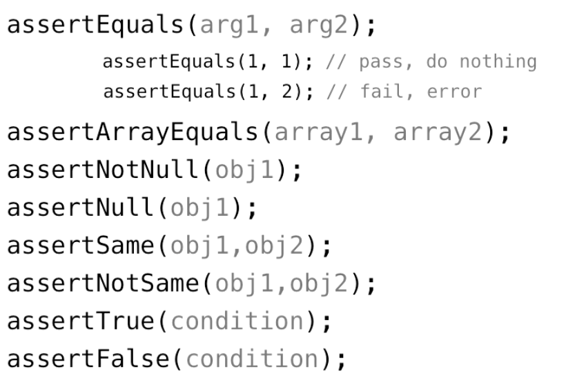
Assertions with JUnit framework

Slide 16
Create a Basic Test

Slide 17
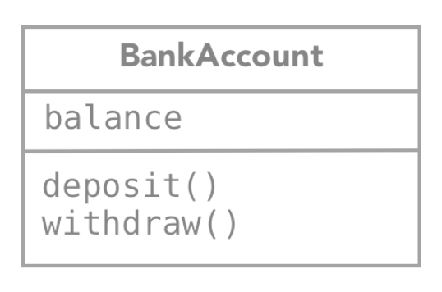
Create new BankAccount object
Deposit 50
Check balance is 50 test
Withdraw 30
Check balance is 30 test

Slide 18
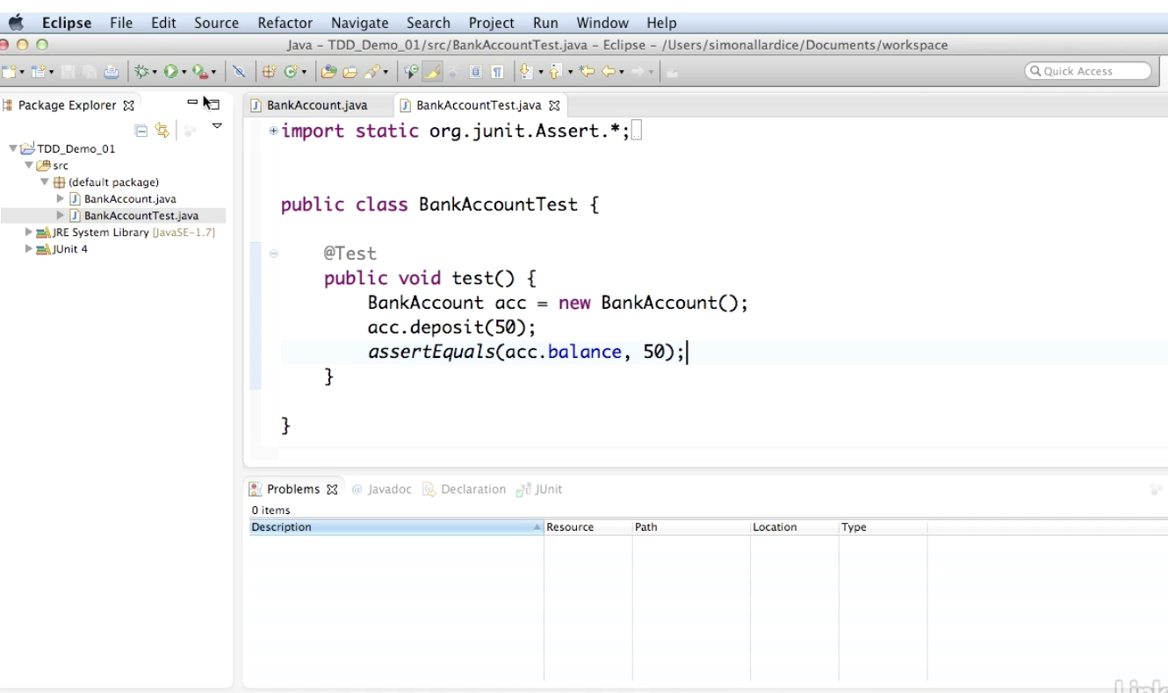

Slide 19
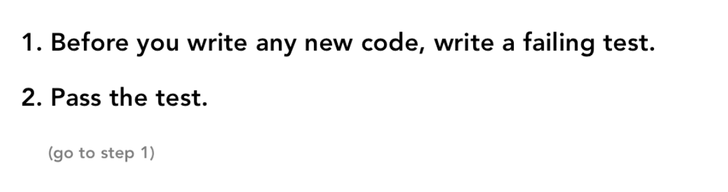
TDD (2 simple steps)

Slide 20
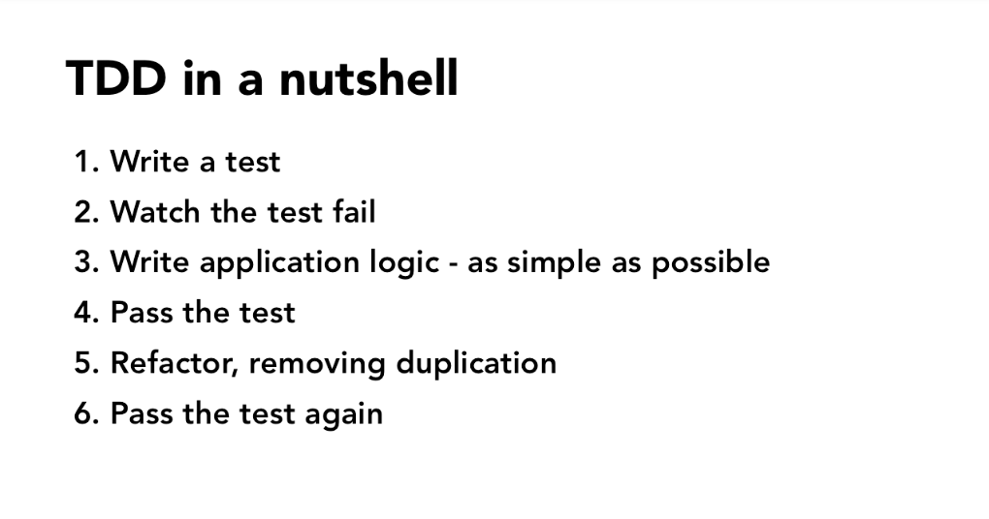

Slide 21
Create a multiple test methods

Slide 22
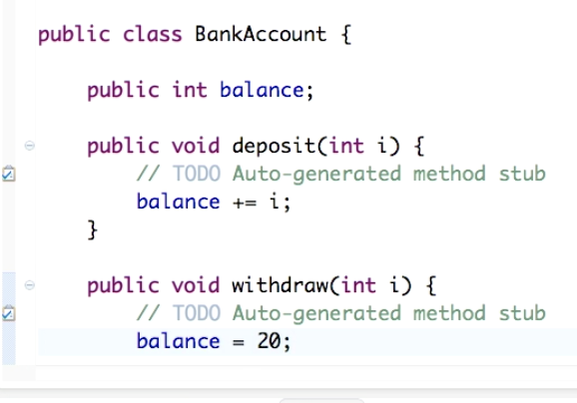

Slide 23
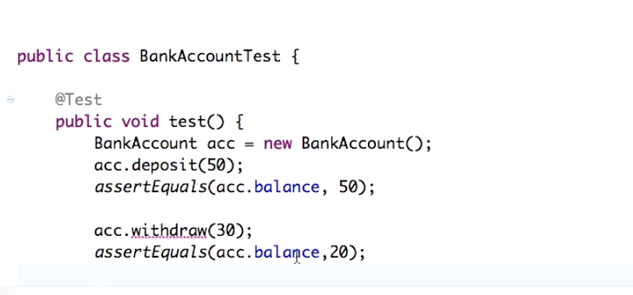

Slide 24
“Test until fear turns to boredom”

Slide 25
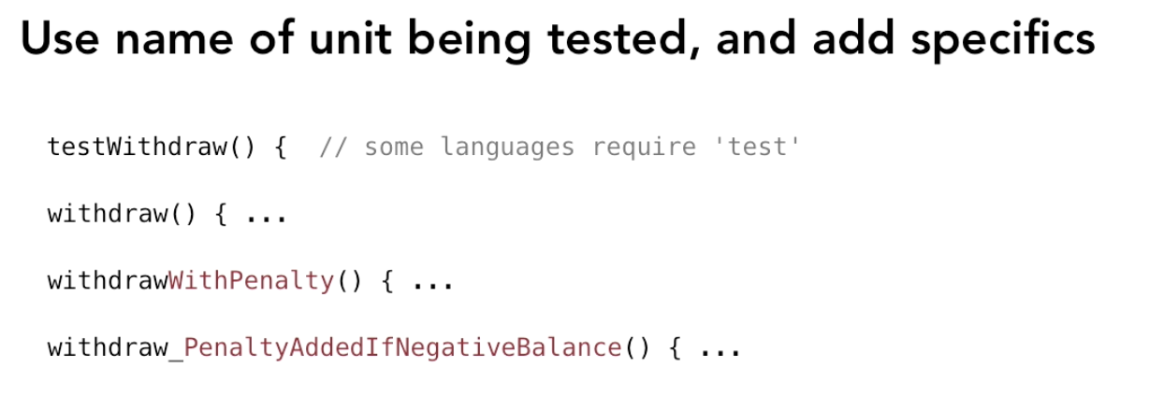
Naming test methods

Slide 26
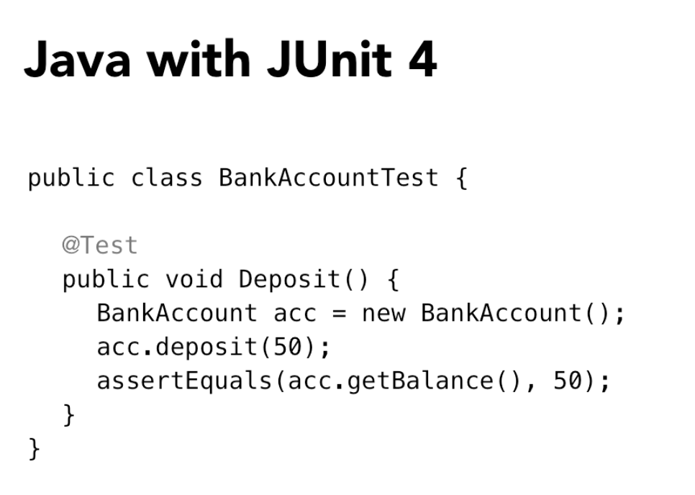

Slide 27
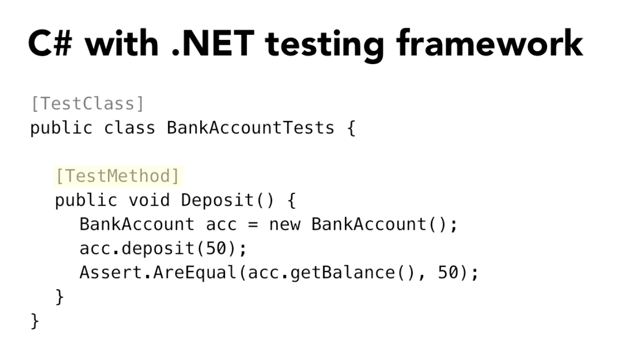

Slide 28
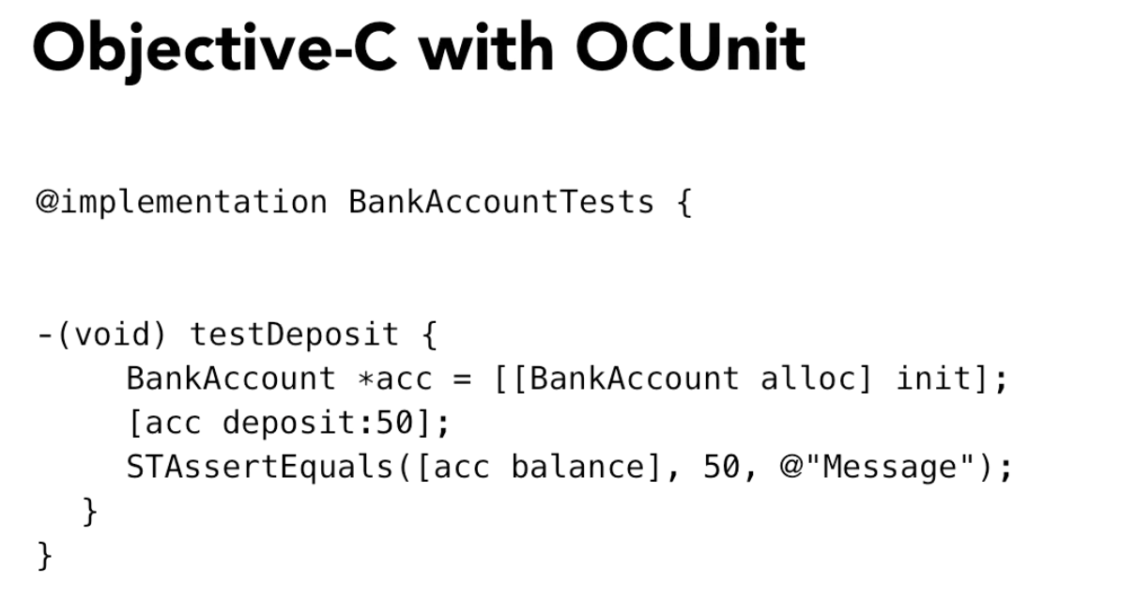

Slide 29
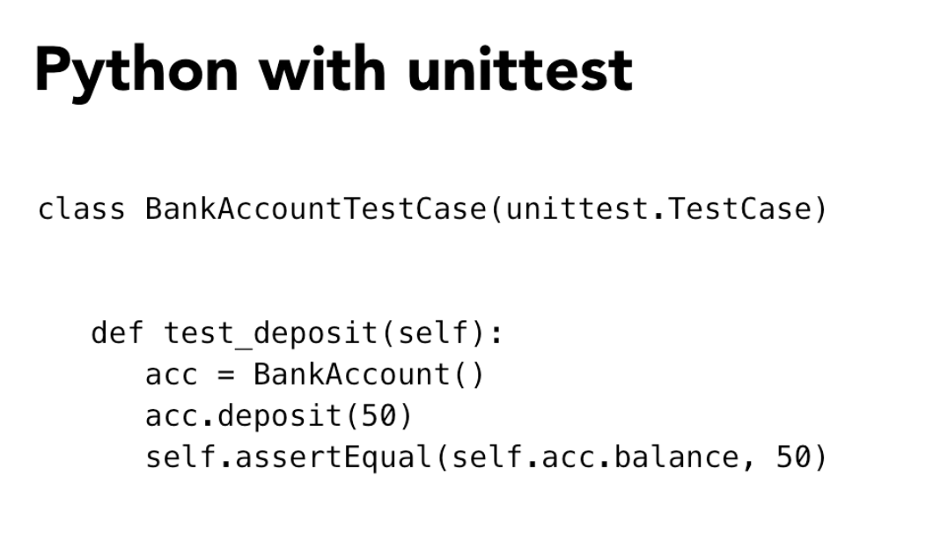

Slide 30
Testing Return Values

Slide 31
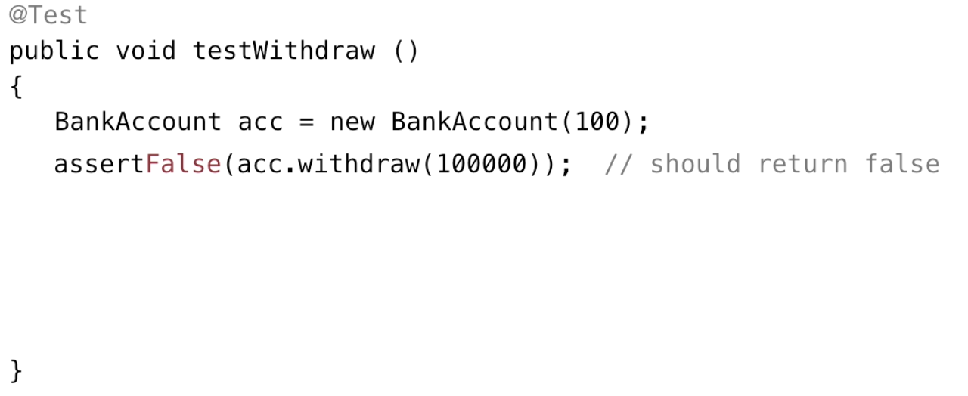
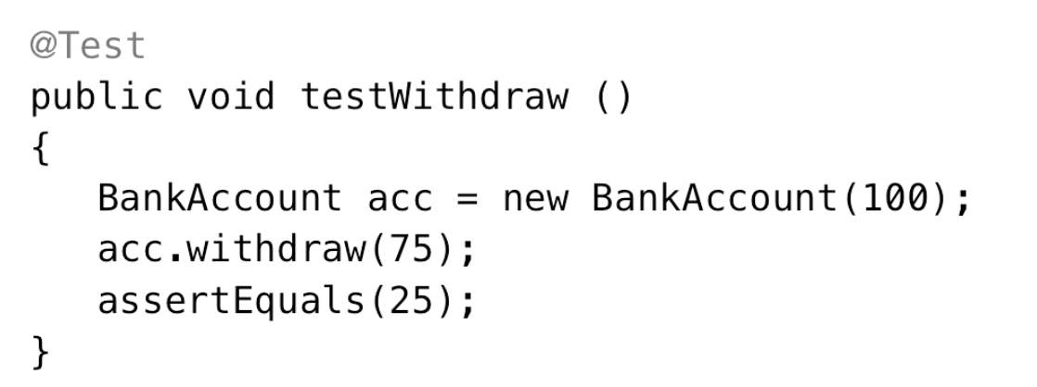
Directly testing a return value

Slide 32
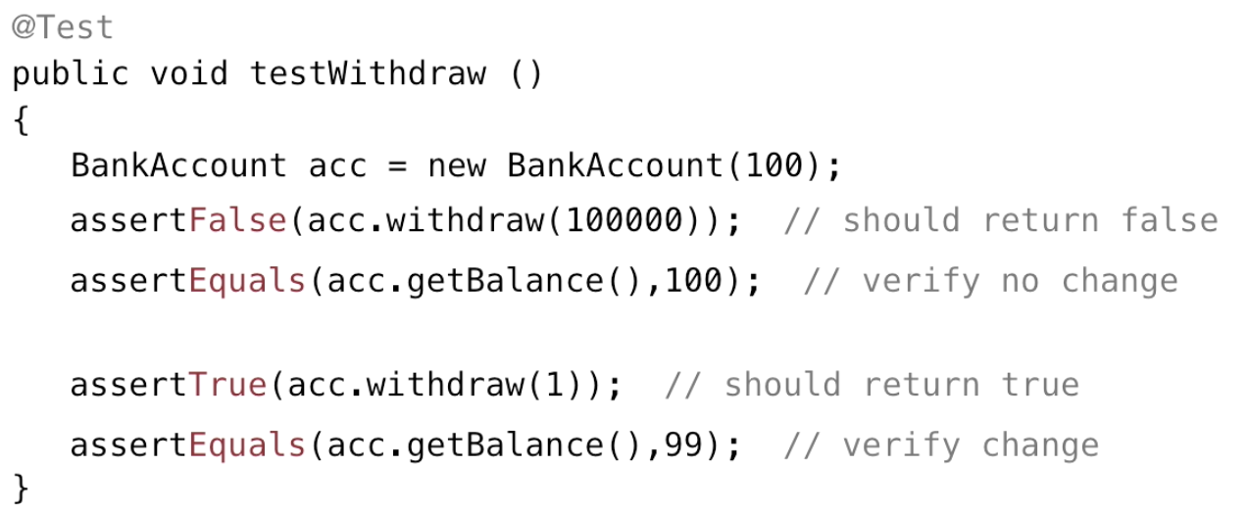
Testing multiple results

Slide 33
Testing for Expected Exceptions

Slide 34
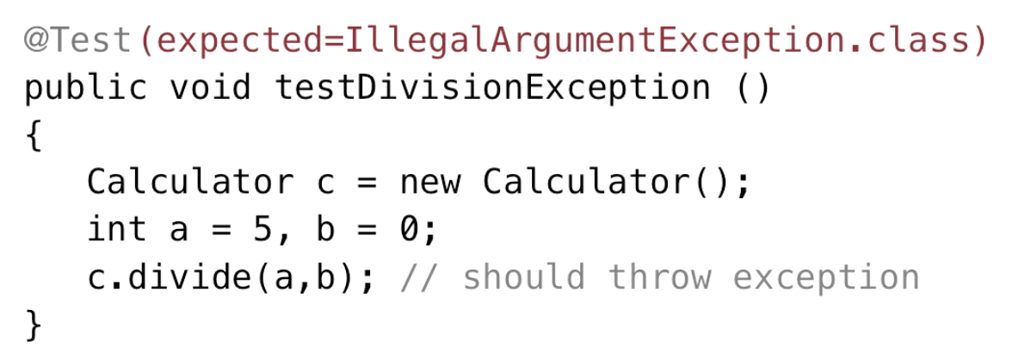
Testing expected exceptions - JUnit

Slide 35
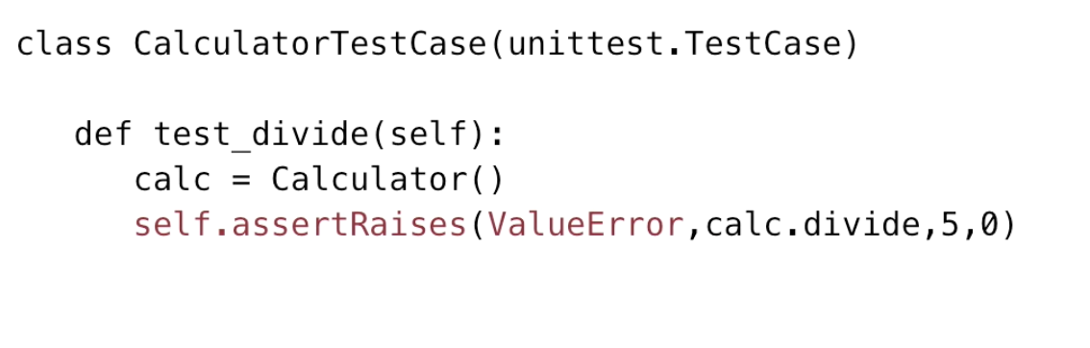
Testing exceptions in Python

Slide 36
Setting up and tearing down

Slide 37
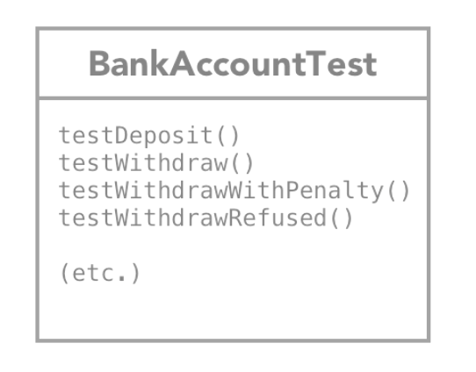

Slide 38
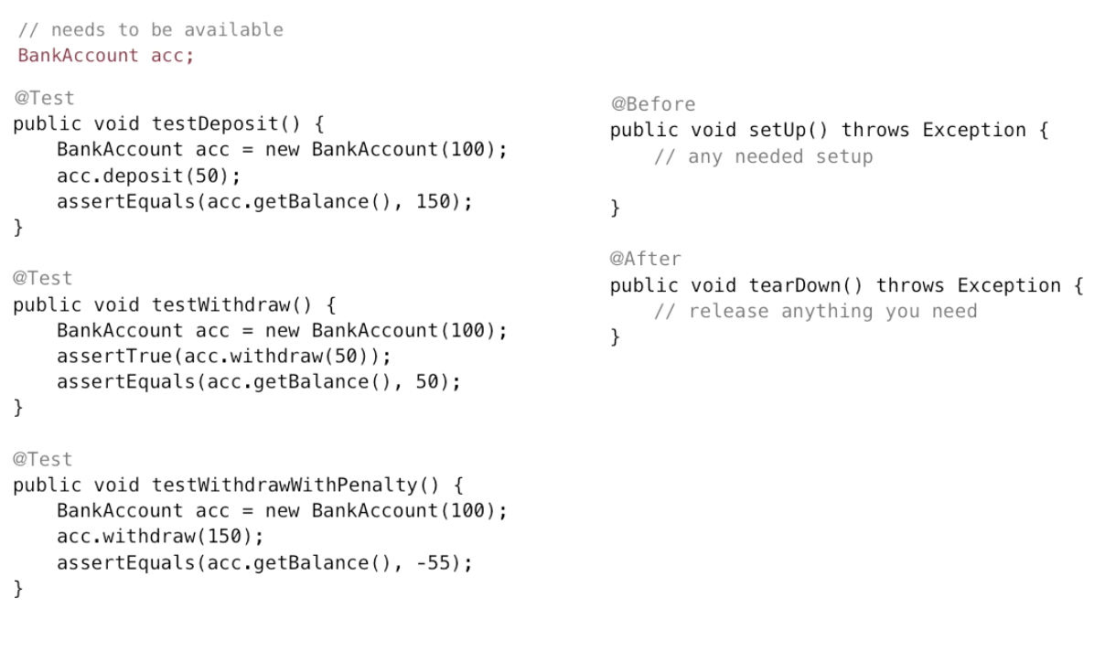

Slide 39
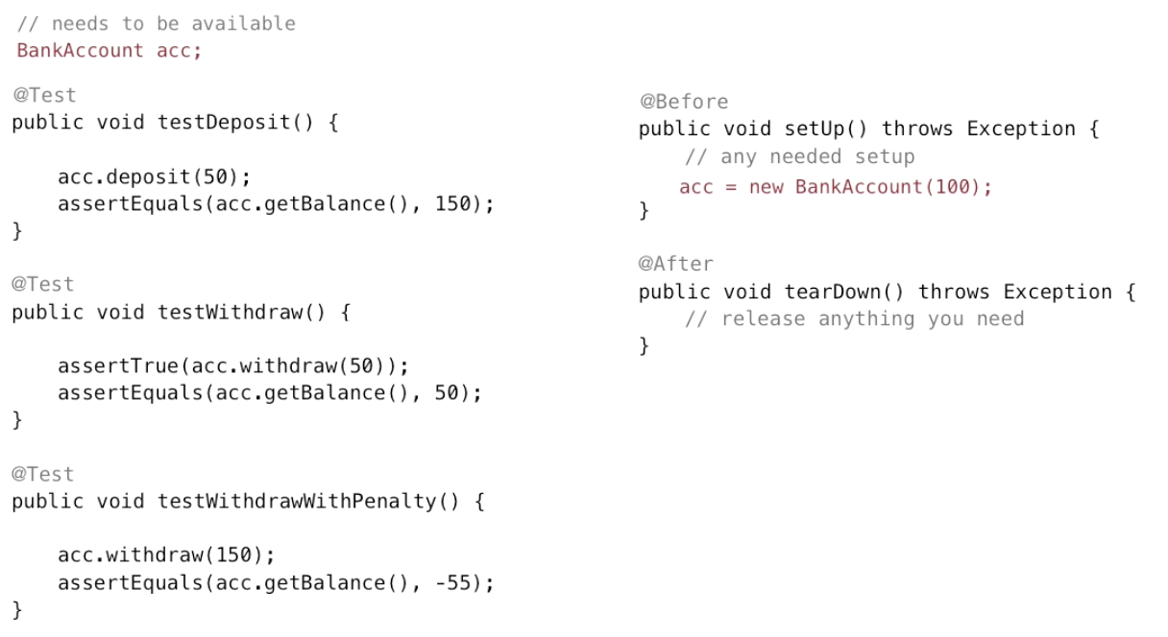

Slide 40
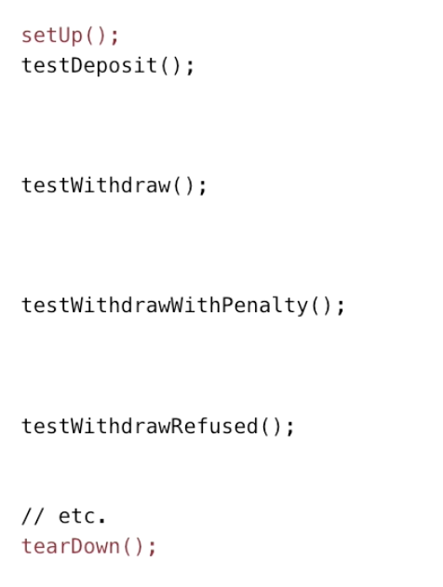
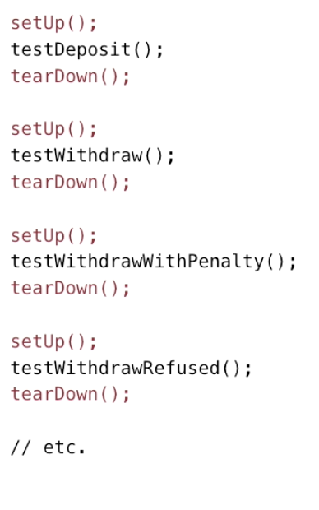

Slide 41
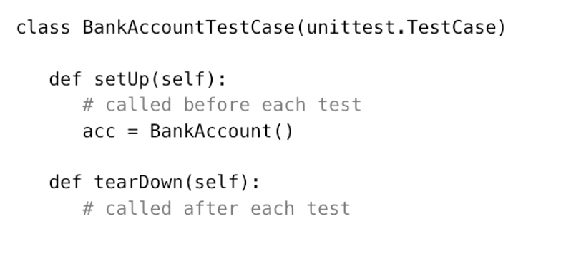
Setting up, tearing down - Python

Slide 42
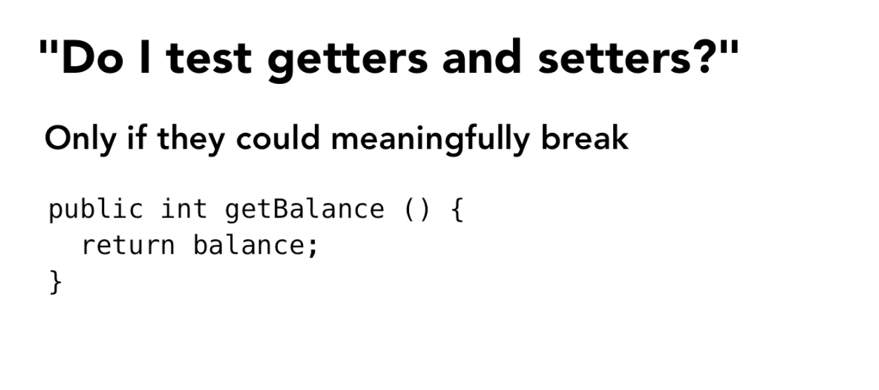

Slide 43
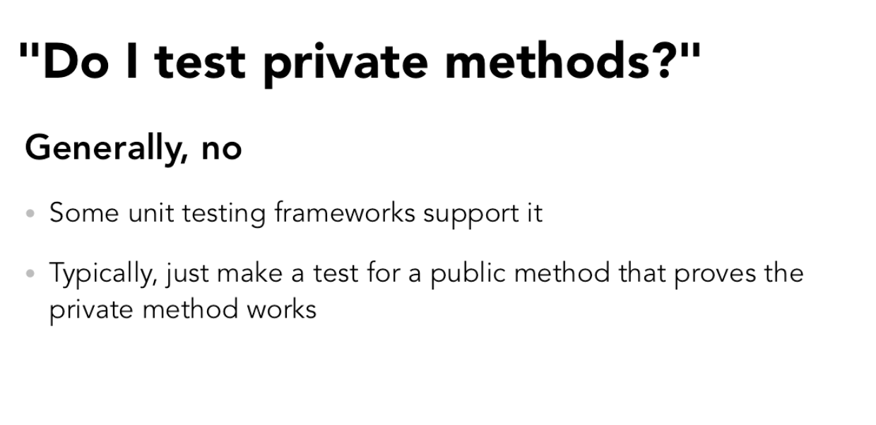

Slide 44
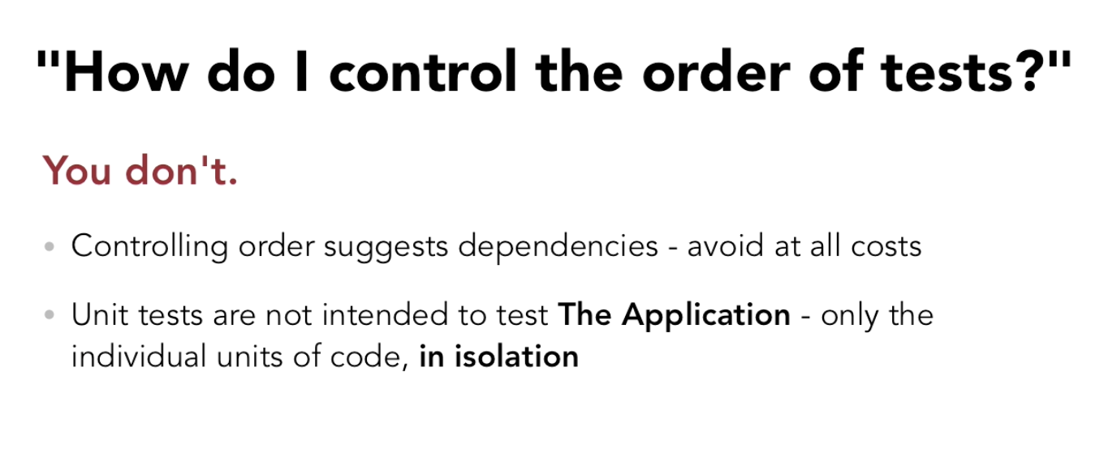

Slide 45
Mock Objects

Slide 46
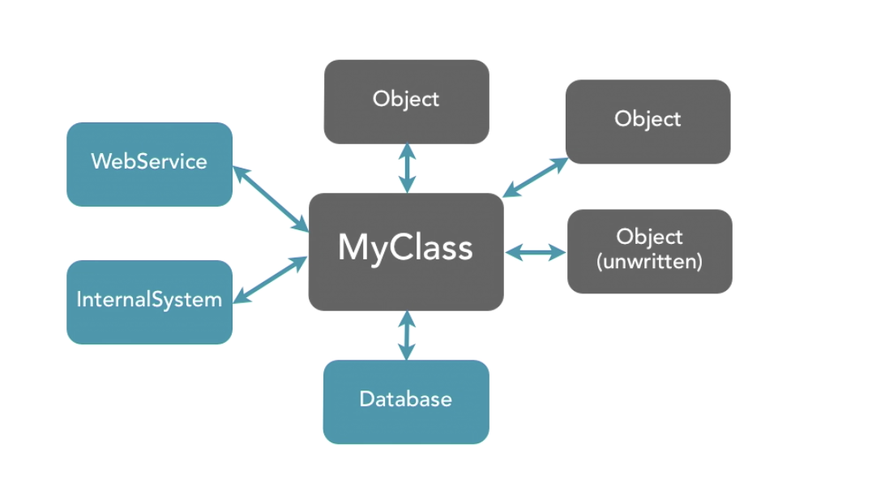

Slide 47
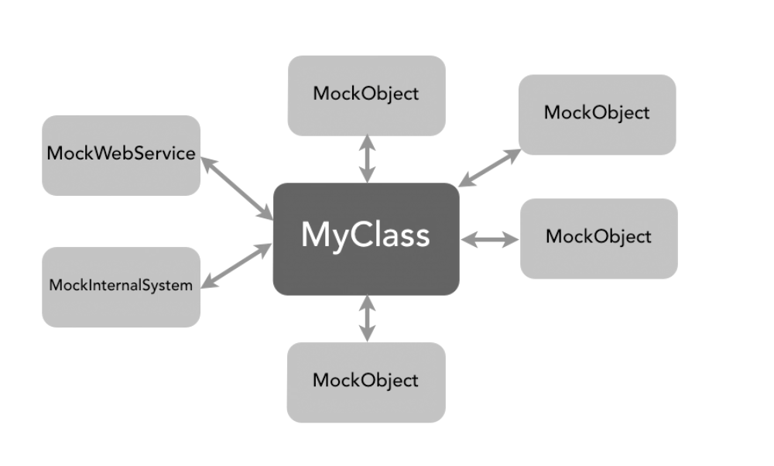

Slide 48
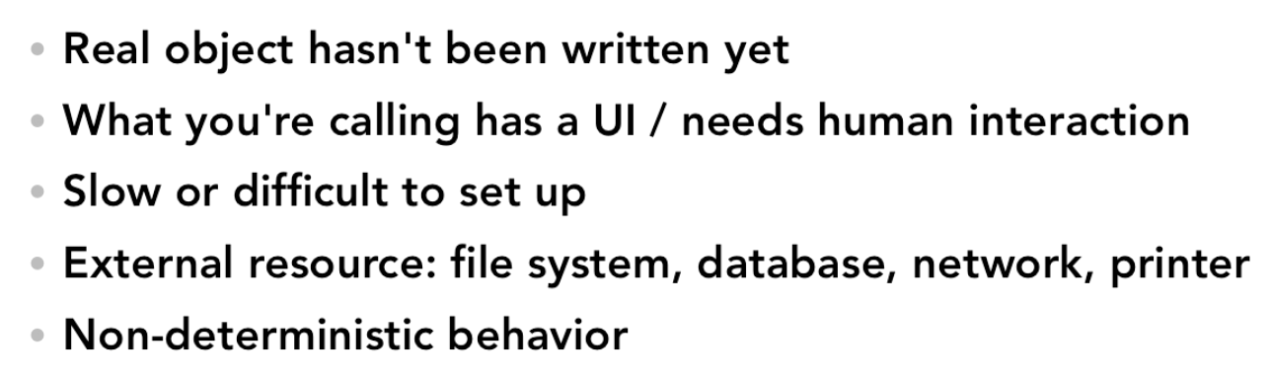
Typical reasons for Mock Objects

Slide 49
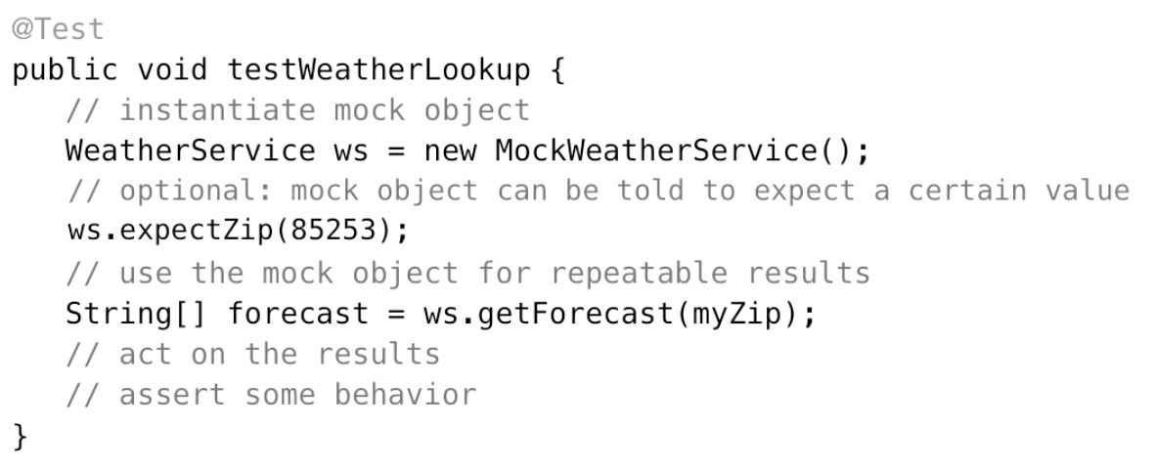
Testing with Mocks

Slide 50
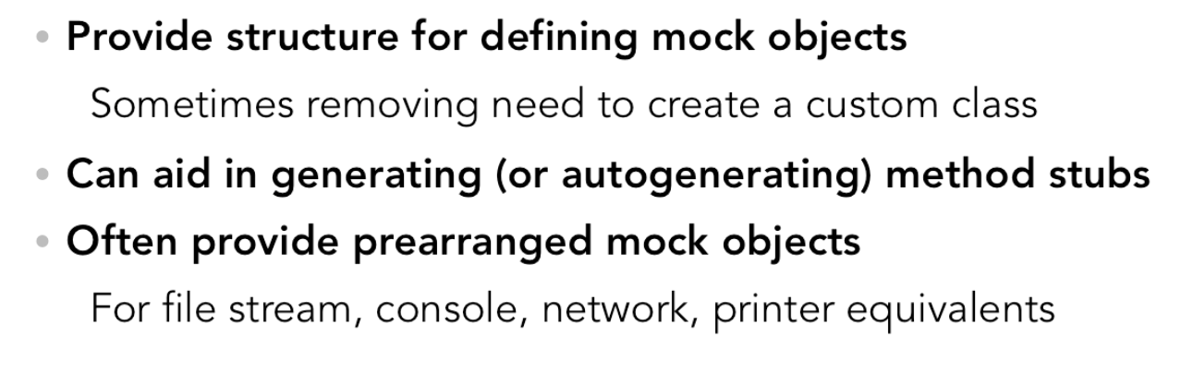
Mock Object Frameworks
http://jmock.org http://code.google.com/p/mockito
http://easymock.org http://goo.gl/S80sL http://ocmock.org

Slide 51
TDD Recommendations

Slide 52
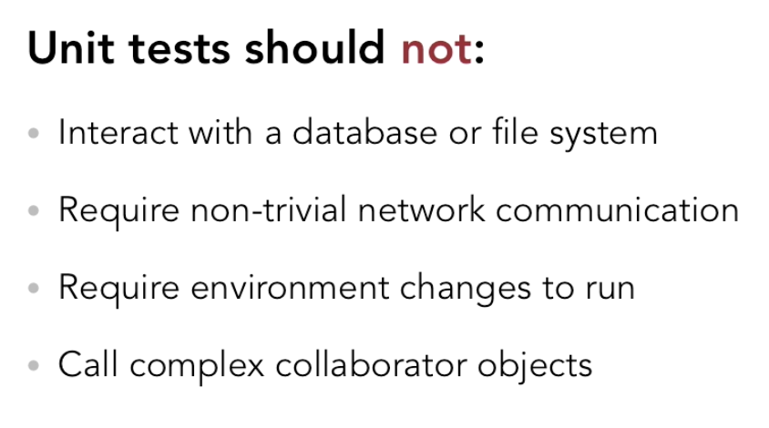
What to avoid

Slide 53


